Slide 1
TREE
Data structure

Slide 2
TREE Definition
A tree consists of finite set of elements(nodes)
There is a special data item called the root of tree,
The remaining data items are partitioned into a number of disjoint subsets, each of which is itself a tree, called as sub trees.
The tree with no nodes is called the null or empty tree.
No cycle is present.

Slide 3
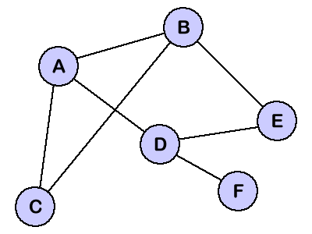
TREE Definition (contd.)
IS it tree?

Slide 4
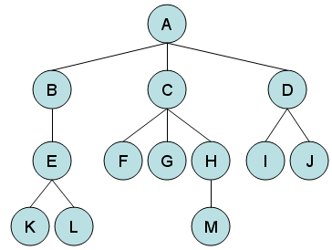
TREE Definition (contd.)

Slide 5
TREE Definition (contd.)
A tree is a widely used abstract type data (ADT).
METHOD | DESCRIPTION
root() | Return the tree’s root; error if tree is empty
parent(v) | Return v’s parent; error if v is a root
children(v) | Return v’s children
isRoot(v) | Test whether v is a root
isEmpty() | Test whether the tree has any node or not
size() | Return the number of nodes in the tree

Slide 6
Tree Terminology
Node
Each data items of a tree is called a node. It contains the information and links to other data items.
Edge is connecting line
of two nodes.
-How many nodes?

Slide 7
Tree Terminology
Root
It is special node which appears as the first node in the hierarchical arrangement of data items.

Slide 8
Parent
Parent of a node is the immediate predecessor of a node. A is the parent of B,C,D.

Slide 9
Child
Child of a node is immediate successor of a node. B,C,D are the children of A.

Slide 10
Siblings
The child nodes of same parent nodes is called siblings.
B,C,D are siblings of
parent node A

Slide 11
Degree of a node
The number of children that can exist for a node is called the degree of that node.
A➔3
B➔1
C➔3
D➔2
J➔0

Slide 12
Degree of a tree
Maximum degree of nodes in a tree is called the degree of tree.
Degree of a tree➔3

Slide 13
Terminal node
A node of degree zero is called terminal node or leaf.

Slide 14
Non-Terminal node
Any node whose degree is not zero is called non-terminal node.

Slide 15
Level
The root node is always at level ‘0’. In general, if a node is at level n, then its children will be at level n+1.
Level 0
Level 1
Level 2
Level 3

Slide 16
Path
path is a sequence of consecutive edges from the source node to destination node.
-The path between A
and M is-
(A,C),(C,H),(H,M)

Slide 17
Depth
The length of the unique path from the root to the node itself i.e. the level of the node in that tree.
- Depth of node M➔3

Slide 18
Height
The height of a node is the length of the longest path from that node to leaf. Height of a tree is height of root.
Height of A➔3
Height of M➔0

Slide 19
Ancestor
If there is a path from n₁ to n₂ then n₁ is ancestor of n₂ .
Ancestors of E➔
B,A

Slide 20
Descendant
If there is a path from n₁ to n₂ then n₂ is descendant of n₁ .
descendant of E➔
K,L
descendant of C➔
F,G,H,M

Slide 21
Subtree
A subtree is any connected structure below the root.
The first node in the subtree is known is the root of the subtree.

Slide 22
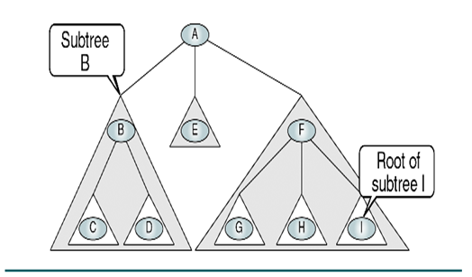

Slide 23
Binary Tree
A binary tree is defined as a finite set of data items is either empty or consists of a single item called the root and two disjoint binary trees called the left sub tree and right sub tree.
Each node of the tree has at most two children.

Slide 24
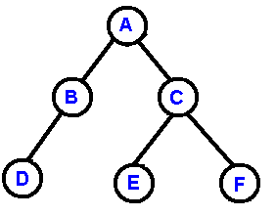

Slide 25
Some Properties of Binary Tree
A binary tree with n nodes has exactly (n-1) number of edges or branches.
The maximum numbers of node on level i of a binary tree is 2^{i}, i>=0.
The maximum number of nodes in a binary tree of height h is 2^{h}-1.

Slide 26
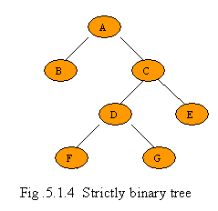
Strictly Binary tree
If every non leaf node in a binary tree has non empty left and right subtrees. Then it is strictly binary tree.

Slide 27
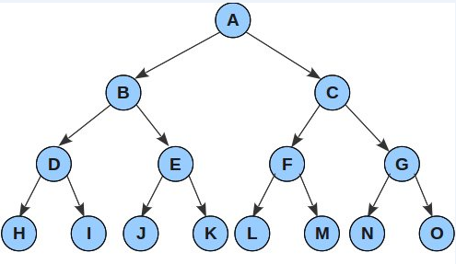
Complete Binary Tree
A complete binary tree is a strictly binary tree all of whose terminal nodes are at same level.

Slide 28
Memory Representation of Binary Tree
Binary tree can be represented in two ways
Array representation.
Linked representation.

Slide 29
Array Representation
An array can be used to store the nodes of a binary tree.
The nodes can be accessed in sequence one after another.
The root of the binary tree is stored in a[0].
If a node is stored in a[i], then its left child is stored in a[2*i+1], its right child is stored in a[2*i+2].

Slide 30
Array Representation
Array is a[].
0 1 2 3 4 5 6
A
B
C
D
E
F

Slide 31
Linked Representation
The Structure used to represent a node of a binary tree in a linked list
struct node
{
int data;
struct node * left;
struct node * right;
}

Slide 32
Linked Representation
A
B
X
C
X
E
X
X
F
X
X
D
X

Slide 33
Binary Tree Traversal
It is a way in which each node in the tree is visited exactly once in a systematic manner. This process is called tree traversal. Three way:
Preorder Traversal
Inorder Traversal
Postorder Traversal

Slide 34
Preorder Traversal
It is also known as depth-first order traversal.
The procedure
Visit the root node
Traverse the left subtree in preorder
Traverse the right subtree in preorder

Slide 35
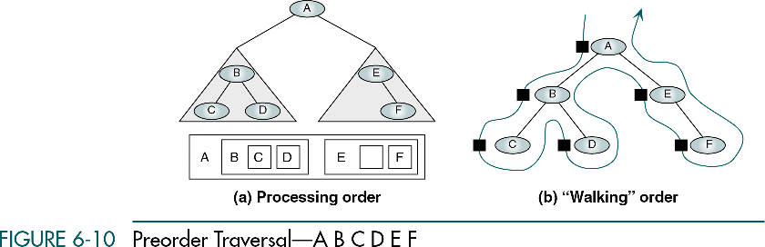
Preorder Traversal

Slide 36
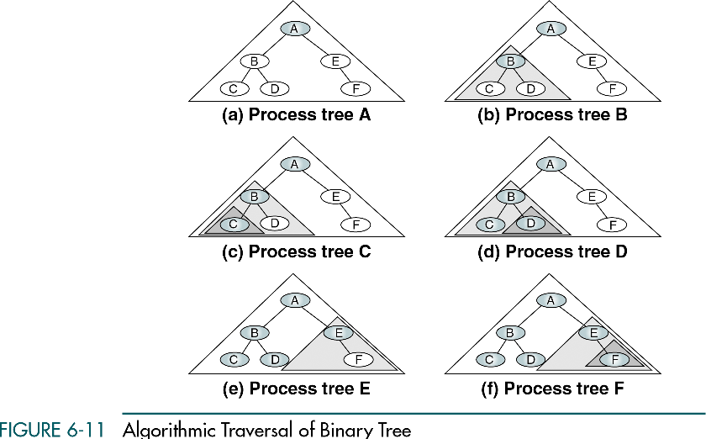

Slide 37
Preorder Traversal
Algorithm
preorder(root)
if (root is not NULL)
Print(root)
preorder(root->left)
preorder(root->right)
end if
end preorder

Slide 38
Inorder Traversal
It is also known as symmetric order traversal.
The procedure
Traverse the left subtree in inorder
Visit the root node
Traverse the right subtree in inorder

Slide 39
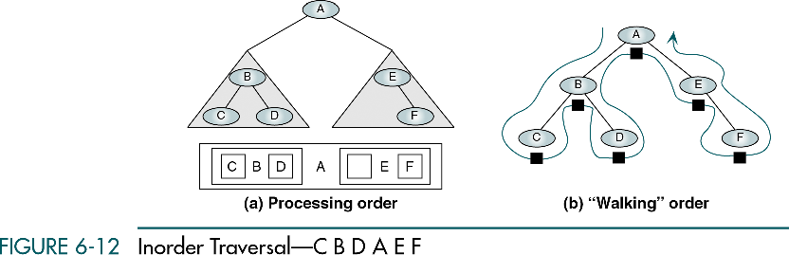
Inorder Traversal

Slide 40
Inorder Traversal
Algorithm
inorder(root)
if (root is not NULL)
inorder(root->left)
Print(root)
inorder(root->right)
end if
end inorder

Slide 41
Postorder Traversal
The procedure
Traverse the left subtree in postorder
Traverse the right subtree in postorder
Visit the root node

Slide 42
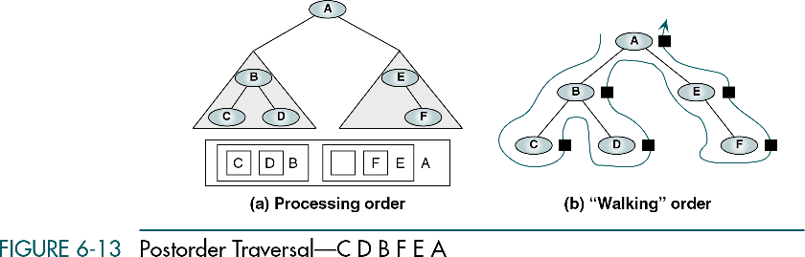
Postorder Traversal

Slide 43
Postorder Traversal
Algorithm
postorder(root)
if (root is not NULL)
postorder(root->left)
postorder(root->right)
Print(root)
end if
end postorder

Slide 44
Binary Tree Traversal
A
B
C
D
E
F
G
Preorder:- A B D E C F G
Inorder:- D B E A F C G
Postorder:- D E B F G C A

Slide 45
Construction of Binary Tree
The preorder, inorder and postorder traversal of different binary trees may result in same sequence of nodes.
The original tree cannot be reconstructed from a given preorder or inorder or postorder traversal alone.

Slide 46
Construction of Binary Tree
Example-1
Preorder- A B D G H E C F I J
Inorder- G D H B E A I F J C

Slide 47
Construction of Binary Tree
Preorder- A B D G H E C F I J Inorder- G D H B E A I F J C
Step-1
A
Preorder- B D G H E
Inorder- G D H B E
Preorder- C F I J
Inorder- I F J C

Slide 48
Construction of Binary Tree
Preorder- A B D G H E C F I J Inorder- G D H B E A I F J C
Step-2
A
B
C
Pr- D G H
Ir- G D H
E
Pr- F I J
Ir- I F J

Slide 49
Construction of Binary Tree
Preorder- A B D G H E C F I J Inorder- G D H B E A I F J C
Step-3
A
B
C
D
E
F
G
H
I
J

Slide 50
Construction of Binary Tree
Example-2
Preorder- A B D G E H I C F J
Inorder- G D B H E I A F J C

Slide 51
Construction of Binary Tree
Preorder- A B D G E H I C F J Inorder- G D B H E I A F J C
Step-1
A
Preorder- B D G E H I
Inorder- G D B H E I
Preorder- C F J
Inorder- F J C

Slide 52
Construction of Binary Tree
Preorder- A B D G E H I C F J Inorder- G D B H E I A F J C
Step-2
A
B
C
Pr- D G
Ir- G D
Pr- E H I
Ir- H E I
Pr- F J
Ir- F J

Slide 53
Construction of Binary Tree
Preorder- A B D G E H I C F J Inorder- G D B H E I A F J C
Step-3
A
B
C
D
E
F
G
H
I
J

Slide 54
Construction of Binary Tree
Example-3
Postorder- G H D E B I J F C A
Inorder- G D H B E A I F J C

Slide 55
Construction of Binary Tree
Postorder- G H D E B I J F C A Inorder- G D H B E A I F J C
Step-1
A
Postorder- G H D E B
Inorder- G D H B E
Postorder- I J F C
Inorder- I F J C

Slide 56
Construction of Binary Tree
Postorder- G H D E B I J F C A Inorder- G D H B E A I F J C
Step-2
A
B
C
Pr- G H D
Ir- G D H
E
Pr- I J F
Ir- I F J

Slide 57
Construction of Binary Tree
Postorder- G H D E B I J F C A Inorder- G D H B E A I F J C
Step-3
A
B
C
D
E
F
G
H
I
J

Slide 58
Expression Tree
The leaf nodes of expression tree are operands, such constants or variables. Other nodes contain operators.
The expression tree is binary because all operations are binary.

Slide 59
Expression Tree
Expression1:- (2 × (a − 1) + (3 × b))
×
3
b

Slide 60
Expression Tree
Expression1:- (2 × (a − 1) + (3 × b))
−
×
a
1
3
b

Slide 61
Expression Tree
Expression1:- (2 × (a − 1) + (3 × b))
×
×
2
−
3
b
a
1

Slide 62
Expression Tree
Expression1:- (2 × (a − 1) + (3 × b))
+
×
×
2
−
3
b
a
1

Slide 63
Expression Tree
Expression:- (a+b*c)+((d/e-f)*g).
−
/
f
d
e

Slide 64
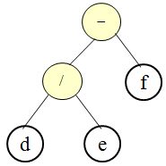
Expression Tree
Expression:- (a+b*c)+((d/e-f)*g).
∗
g

Slide 65
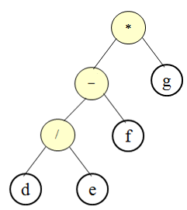
Expression Tree
Expression:- (a+b*c)+((d/e-f)*g).
∗
b
c

Slide 66
Expression Tree
Expression:- (a+b*c)+((d/e-f)*g).
+
∗
a
c
b

Slide 67
Expression Tree
Expression:- (a+b*c)+((d/e-f)*g).
+
+
∗
a
c
b

Slide 68
Binary Search Tree(BST)
A binary search tree is a binary tree which is empty or satisfies the following properties-
The value of the nodes of the left subtree is less than the value of the root.
The value of the nodes of the right subtree is greater than or equal to the value of the root.
Both the subtrees of left and right children follow the above two properties.

Slide 69
Operation on BST
Structure of a node of BST
struct node_type
{
int data;
struct node_type * left, * right;
};
typedef struct node_type node;
typedef node * tree;
tree root;

Slide 70
Operation on BST
Search a node in BST- [find(root, x)in function call]
If data is present , the find program will return the pointer of the node in which data is present .
If data is not present, then it will return the pointer to the parent under which that data will be inserted.
10
5
30
2
25
45

Slide 71
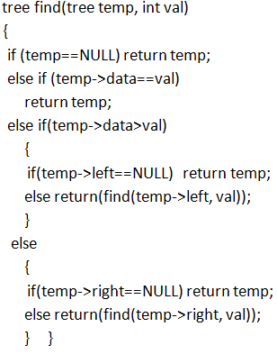

Slide 72
Operation on BST Insertion
Insert ( 20 )
10
10 < 20, right
30 > 20, left
25 > 20, left
Insert 20 on left
5
30
2
25
45
20

Slide 73
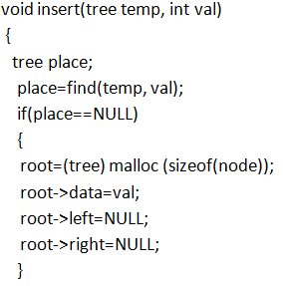
Operation on BST Insertion
[insert(root, x)in function call]

Slide 74
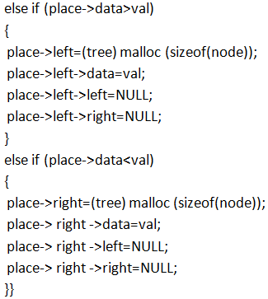
Operation on BST Insertion

Slide 75
Operation on BST Deletion
Algorithm
Perform search for value X
If X is a leaf, delete X
Else // must delete internal node
a) Replace with largest value Y on left subtree
OR smallest value Z on right subtree
b) Delete replacement value (Y or Z) from subtree

Slide 76
Operation on BST Deletion (Leaf)
Delete ( 25 )
10
10
10 < 25, right
30 > 25, left
25 = 25, delete
5
30
5
30
2
25
45
2
45

Slide 77
Operation on BST Deletion (Internal Node)
Delete ( 10 )
10
5
5
5
30
5
30
2
30
2
25
45
2
25
45
2
25
45
Replacing 10 with largest value in left subtree
Replacing 5 with largest value in left subtree
Deleting leaf

Slide 78
Operation on BST Deletion (Internal Node)
Delete ( 10 )
10
25
25
5
30
5
30
5
30
2
25
45
2
25
45
2
45
Replacing 10 with smallest value in right subtree
Deleting leaf
Resulting tree

Slide 79
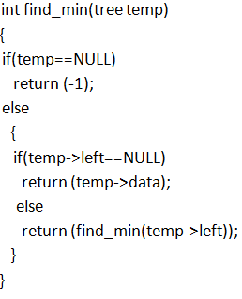
Operation on BST Find Minimum
[find_min(root)in function call]

Slide 80
Threaded Binary Tree
A binary tree is threaded by making
All right child pointers that would normally be null point to the inorder successor (next) of the node (if it exists), and
All left child pointers that would normally be null point to the inorder predecessor of the node.

Slide 81
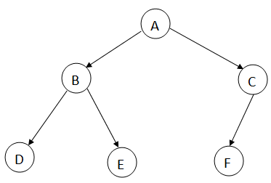
Threaded Binary Tree
Inorder- D, B, E, A, F, C
Binary Tree

Slide 82
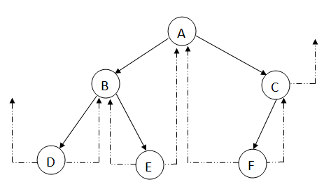
Threaded Binary Tree
Inorder- D, B, E, A, F, C

Slide 83
Threaded Binary Tree
The Structure used to represent a node of threaded binary tree in a linked list
struct node
{
int data;
struct node * left;
struct node * right;
int lthread,rthread;
}
lthread set to 1 when left pointer field will point to inorder predecessor of the node.

Slide 84
AVL Tree
Definition
Adelson-Velskii and Landis
An empty binary tree is AVL balanced.
If T_{L} and T_{R} are left and right subtrees of a non empty BST, then T is said to be height balanced if and only if
T_{L} and T_{R} are both height balanced and
|h_{L}-h_{R}|<=1
Where h_{L} and h_{R} are the heights of T_{L} and T_{R}
Balance factor(bf) of a node is height of its left subtree minus the height of its right subtree.

Slide 85
Is it AVL Tree?
40
30
60
50
20
70

Slide 86
Is it AVL Tree?
0
40
1
0
30
60
0
0
0
50
20
70

Slide 87
Is it AVL Tree?
1
40
2
0
30
60
1
0
0
50
70
20
0
10

Slide 88
AVL Tree
LL Rotation
It is used when a new node is inserted in the left subtree of the left child of the node where |h_{l}-h_{r}|>1.

Slide 89
Example-1
14
14
Insert 12
13
13
12
LL
13
12
14

Slide 90
Example-2
0
1
40
40
1
0
insert
2
0
30
60
10
30
60
0
0
0
0
1
0
50
50
20
70
20
70
0
10
0
40
0
0
20
60
0
0
0
0
50
10
70
30

Slide 91
AVL Tree
RR Rotation
It is used when a new node is inserted in the right subtree of the right child of the node where |h_{l}-h_{r}|>1.

Slide 92
Example-1
14
14
Insert 16
15
15
16
15
RR
14
16

Slide 93
Example-2
0
1
40
insert
40
0
1
20
50
0
2
70
20
50
0
0
0
0
1
10
60
0
30
10
60
30
0
70
0
40
0
0
20
60
0
0
0
0
10
70
30
50

Slide 94
AVL Tree
LR Rotation (RR+LL)
It is used when a new node is inserted in the right subtree of the left child of the node where |h_{l}-h_{r}|>1.

Slide 95
Example-1
C
C
insert
A
A
B
C
C
B
LR
A
RR
LL
B
A
C
B
A

Slide 96
Example-2
13
11
15
14
16
10
12
1
2

Slide 97
Example-2 (cont.)
Insert 2-
2
13
2
0
11
15
2
16
10
12
14
1
1
0
2
LR rotation

Slide 98
Example-2 (cont.)
RR rotation
13
11
15
14
16
10
12
1
2

Slide 99
Example-2 (cont.)
13
11
15
14
16
10
12
2
1

Slide 100
Example-2 (cont.)
LL rotation
13
11
15
14
16
10
12
2
1

Slide 101
Example-2 (cont.)
13
11
15
2
12
14
16
1
10

Slide 102
AVL Tree
RL Rotation (LL+RR)
It is used when a new node is inserted in the left subtree of the right child of the node where |h_{l}-h_{r}|>1.

Slide 103
Example-1
2
A
A
insert
1
C
C
0
B
A
A
B
RL
LL
RR
C
B
A
C
B
C

Slide 104
Example-2
1
40
0
0
20
70
0
0
50
80

Slide 105
Example-2 (contd.)
2
Insert 60-
40
1
0
20
70
1
0
50
80
0
60
RL rotation

Slide 106
Example-2 (contd.)
2
LL Rotation
40
1
0
20
70
1
0
50
80
0
60

Slide 107
Example-2 (contd.)
40
20
50
70
80
60

Slide 108
Example-2 (contd.)
RR Rotation
40
20
50
70
80
60

Slide 109
Example-2 (contd.)
50
40
70
20
80
60

Slide 110
AVL Tree Rotations
Single rotations: insert 14, 15, 16, 13, 12, 11, 10, 1, 2, 3
First insert 14 and 15:
14
15
Now insert 16.

Slide 111
AVL Tree Rotations
Single rotations:
Inserting 16 causes AVL violation:
14
15
16
Need to rotate.

Slide 112
AVL Tree Rotations
Single rotations:
Inserting 16 causes AVL violation:
14
15
16
Need to rotate.

Slide 113
AVL Tree Rotations
Single rotations:
Rotation type:
14
15
16

Slide 114
AVL Tree Rotations
Single rotations:
Rotation restores AVL balance:
15
14
16

Slide 115
AVL Tree Rotations
Single rotations:
Now insert 13 and 12:
15
14
16
13
12
AVL violation - need to rotate.

Slide 116
AVL Tree Rotations
Single rotations:
Rotation type:
15
14
16
13
12

Slide 117
AVL Tree Rotations
Single rotations:
15
13
16
12
14
Now insert 11.

Slide 118
AVL Tree Rotations
Single rotations:
15
13
16
12
14
11
AVL violation – need to rotate

Slide 119
AVL Tree Rotations
Single rotations:
Rotation type:
15
13
16
12
14
11

Slide 120
AVL Tree Rotations
Single rotations:
13
12
15
14
16
11
Now insert 10.

Slide 121
AVL Tree Rotations
Single rotations:
13
12
15
14
16
11
10
AVL violation – need to rotate

Slide 122
AVL Tree Rotations
Single rotations:
Rotation type:
13
12
15
14
16
11
10

Slide 123
AVL Tree Rotations
Single rotations:
13
11
15
10
12
14
16
AVL balance restored.

Slide 124
AVL Tree Rotations
Double rotations:
First insert 1 and 2:
13
11
15
10
12
14
16

Slide 125
AVL Tree Rotations
Double rotations:
AVL violation - rotate
13
11
15
14
16
10
12
1
2

Slide 126
AVL Tree Rotations
Double rotations:
Rotation type: LR
13
11
15
14
16
10
12
1
2

Slide 127
AVL Tree Rotations
Double rotations:
AVL balance restored:
13
11
15
2
12
14
16
1
10
Now insert 3.

Slide 128
AVL Tree Rotations
Double rotations:
AVL violation – rotate:
13
11
15
2
12
14
16
1
10
3

Slide 129
AVL Tree Rotations
Double rotations:
Rotation type:
13
11
15
2
12
14
16
1
10
3

Slide 130
AVL Tree Rotations
AVL balance restored:
13
10
15
2
11
14
16
1
3
12

Slide 131
B-Tree
Definition : A B-Tree of order m (m>=2) is an m-way search tree T in which
The root of T is either a leaf or has between 2 and m children.
Each node except the root has a maximum of m children and a minimum of m/2 children.
The maximum number of keys in each node is one less than the number of children nodes with a maximum of (m-1) keys. (The minimum number of keys in a non-root is (m-1)/2.)
All leaves are on the same level.

Slide 132
Insertion in B-Tree
To insert a key requires a search operation to find the leaf node where the new element should be added.
If the leaf node is not full there is room for one more element and insert the new key into that existing leaf node, keeping the node’s elements ordered. Example
If the leaf node is full (m-1 keys) the leaf node is splits into two nodes before the new key can be inserted by performing the following operation:

Slide 133
Insertion in B-Tree
A single median is chosen from among the leaf’s old (m-1) elements and the new element.
The median key moves up into node’s parent to identify the dividing point between the two new nodes.
Values less than the median are put in the new left node and values greater than the median are put in the new right node.

Slide 134
Insertion in B-Tree
Example for step 1
B-Tree of order 4
Each node has at most 4 pointers and 3 keys, and at least 2 pointers and 1 key.

Slide 135
Insertion in B-Tree
Insert: 5, 3, 21
5
3 5
3 5 21

Slide 136
Insertion in B-Tree
Example for step 2
Insert 9
9
3 5
21

Slide 137
Insertion in B-Tree (example-1)
B-Tree of order 4
Each node has at most 4 pointers and 3 keys,
and at least 2 pointers and 1 key.
Insert: 5, 3, 21, 9, 1, 13, 2, 7, 10, 12, 4, 8

Slide 138
Insertion in B-Tree (example-1)
Insert: 5, 3, 21
5
3 5
3 5 21

Slide 139
Insertion in B-Tree (example-1)
Insert 9
9
3 5
21

Slide 140
Insertion in B-Tree (example-1)
Insert 1
9
1 3 5
21

Slide 141
Insertion in B-Tree (example-1)
Insert 13
9
1 3 5
13 21

Slide 142
Insert 2
Insertion in B-Tree (example-1)
3 9
1 2
5
13 21

Slide 143
Insertion in B-Tree (example-1)
Insert 7, 10
3 9
1 2
5 7
10 13 21

Slide 144
Insertion in B-Tree (example-1)
Insert 12
3 9 13
1 2
5 7
10 12
21

Slide 145
Insertion in B-Tree (example-1)
Insert 4
3 9 13
1 2
4 5 7
10 12
21

Slide 146
Insertion in B-Tree (example-1)
Insert 8
9
3 7
13
1 2
4 5
8
10 12
21

Slide 147
Insertion in B-Tree (example-2)
B-Tree of order 5
Insert: 10, 40, 35, 15, 60, 25, 45, 70, 55,
30, 90, 50, 85, 99, 20, 65, 75, 95, 97, 80

Slide 148
Insertion in B-Tree (example-2)
Insert: 10, 40, 35, 15
10
10 40
10 35 40
10 15 35 40

Slide 149
Insertion in B-Tree (example-2)
Insert 60
35
10 15
40 60

Slide 150
Insertion in B-Tree (example-2)
Insert 25, 45, 70
35
10 15 25
40 45 60 70

Slide 151
Insert 55
Insertion in B-Tree (example-2)
35 55
10 15 25
40 45
60 70

Slide 152
Insert 30, 90, 50, 85
Insertion in B-Tree (example-2)
35 55
10 15 25 30
40 45 50
60 70 85 90

Slide 153
Insert 99
Insertion in B-Tree (example-2)
35 55 85
10 15 25 30
40 45 50
60 70
90 99

Slide 154
Insert 20
Insertion in B-Tree (example-2)
20 35 55 85
10 15
25 30
40 45 50
60 70
90 99

Slide 155
Insert 65, 75, 95, 97
Insertion in B-Tree (example-2)
20 35 55 85
10 15
25 30
40 45 50
60 65 70 75
90 95 97 99

Slide 156
Insert 80
Insertion in B-Tree (example-2)
55
20 35
70 85
10 15
25 30
40 45 50
60 65
75 80
90 95 97 99

Slide 157
Deletion from a B-tree
During insertion, the key always goes into a leaf. For deletion we wish to remove from a leaf. There are three possible ways we can do this:
If the key is already in a leaf node, and removing it doesn’t cause that leaf node to have too few keys, then simply remove the key to be deleted.
If the key is not in a leaf then it is guaranteed (by the nature of a B-tree) that its predecessor or successor will be in a leaf -- in this case we can delete the key and promote the predecessor or successor key to the non-leaf deleted key’s position.

Slide 158
Deletion from a B-tree (2)
If (1) or (2) lead to a leaf node containing less than the minimum number of keys then we have to look at the siblings immediately adjacent to the leaf in question:
if one of them has more than the min. number of keys then we can promote one of its keys to the parent and take the parent key into our lacking leaf.
if neither of them has more than the min. number of keys then the lacking leaf and one of its neighbours can be combined with their shared parent (the opposite of promoting a key) and the new leaf will have the correct number of keys; if this step leave the parent with too few keys then we repeat the process up to the root itself, if required.

Slide 159
Type #1: Simple leaf deletion
Assuming a 5-way
B-Tree, as before...
12
29
52
2
7
9
15
22
31
43
56
69
72
Delete 2: Since there are enough
keys in the node, just delete it

Slide 160
Type #2: Simple non-leaf deletion
12
29
52
56
Delete 52
7
9
15
22
31
43
56
69
72
Borrow the predecessor
or (in this case) successor

Slide 161
Type #4: Too few keys in node and its siblings
12
29
56
Join back together
7
9
15
22
31
43
69
72
Too few keys!
Delete 72

Slide 162
Type #4: Too few keys in node and its siblings
12
29
7
9
15
22
31
43
56
69

Slide 163
Type #3: Enough siblings
12
29
Demote root key and
promote leaf key
7
9
15
22
31
43
56
69
Delete 22

Slide 164
Type #3: Enough siblings
12
31
7
9
15
29
43
56
69

Slide 165
B-Tree (Original)
55
20 35
70 85
10 15
25 30
40 45 50
60 65
75 80
90 95 97 99

Slide 166
B-Tree (Deletion)
Delete 45
55
20 35
70 85
10 15
25 30
40 45 50
60 65
75 80
90 95 97 99

Slide 167
B-Tree (Deletion)
Delete 85
55
Move upward 90 and
delete from leaf node
20 35
70 85
90
10 15
25 30
40 50
60 65
75 80
90 95 97 99

Slide 168
B-Tree (Deletion)
Delete 80
55
Move 90 down and
Move 95 up
20 35
70 90
10 15
25 30
40 50
60 65
75 80
95 97 99

Slide 169
B-Tree (Deletion)
Delete 25
55
Combine
20 35
70 95
10 15
25 30
40 50
60 65
75 90
97 99

Slide 170
B-Tree (Deletion)
Combine
55
35
70 95
10 15 20 30
40 50
60 65
75 90
97 99

Slide 171
B-Tree (Deletion)
35 55 70 95
10 15 20 30
40 50
60 65
75 90
97 99

Slide 172
Thank You

